Slide 1
HOUSING PROJECT
BY- POONAM YADAV

Slide 2
AGENDA
Introduction
Problem Statement
Objective
Exploratory Data Analysis (EDA)
Visualization
Inference
Future Work

Slide 3
Conceptual Background of the Domain Problem
You are required to model the price of houses with the available independent variables. This model will then be used by the management to understand how exactly the prices vary with the variables. They can accordingly manipulate the strategy of the firm and concentrate on areas that will yield high returns. Further, the model will be a good way for the management to understand the pricing dynamics of a new marke.

Slide 4
Conceptual Background of the Domain Problem
The project will require knowledge and practice in building Graphs /plots and analysing them to get the relationship between dataset, Knowledge of Different Learning Models to build and predict the required output. Basic Data science concepts to increase the quality of the dataset and Python Knowledge (Coding Language) which will be used to solve the complete Micro Credit Defaulter project. Understanding of calculating R2 Score, MSE, skewness and basic mathematics/statistical approaches will help to build an accurate model for this project.

Slide 5
Exploratory Data Analysis performed on the dataset
1) Checked the shape of the dataset : We have 1168 rows and 81 columns in our dataset.
2) Checked the datatypes of the columns:
We have int, float and object type variable in dataset.
3) There are large amount of null values in the dataset.
5) Outliers are present in most of the columns, We will be required to remove outliers before building the model.
Outliers are checked using BoxPlot method available in python library.

Slide 6
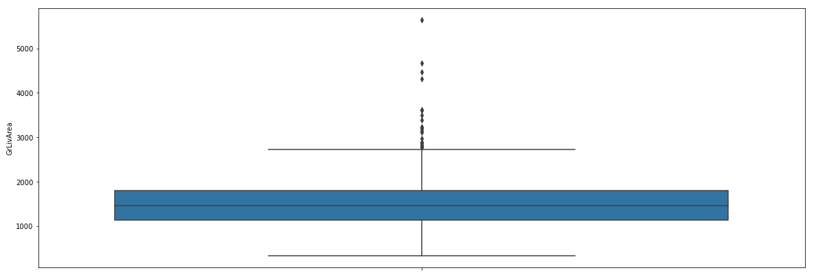
Exploratory Data Analysis performed on the dataset
Outliers Example from our dataset –

Slide 7
Exploratory Data Analysis performed on the dataset
Normal distribution of data:
MSSubClass -> not normally distributed
OverallQual-> Not normally distributed
Overall cond-> Not normally distributed
Year Built -> Not normally distributed
Year remod add->not normally distributed
BsmtFinSF1 ->not normally distributed
GaragerBlt ->not normally distributed
Garage Area -> not normally distributed
The data will be required to be normalized before building any model to increase the accuracy of the model
Normalization of the model is checked by plotting distance plot via libraries available in python

Slide 8
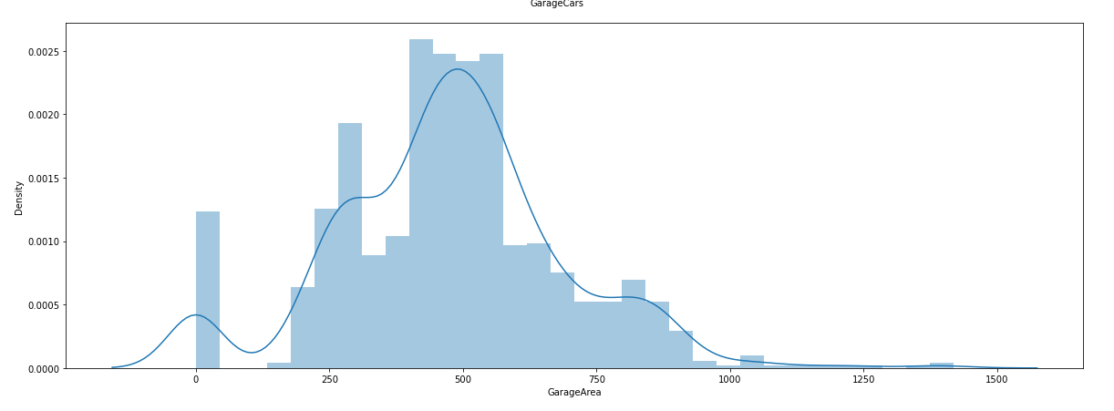
Exploratory Data Analysis performed on the dataset
Exploratory Data Analysis performed on the dataset

Slide 9
Exploratory Data Analysis performed on the dataset
Dataset was highly skewed, Before training the model skewness is required to be removed.
8) Removing Outliers: We replaced the outliers using IQR method. To increase the dataset quality. We confirmed the removal of outliers by plotting BoxPlot for the dataset
Code Logic Snippet:
IQR = df[col].quantile(0.75)-df[col].quantile(0.25)
Barmax = df[col].quantile(0.75) + 1.5*IQR
Barmin = df[col].quantile(0.25) - 1.5*IQR
df.loc[df[col]>Barmax,col] = Barmax
df.loc[df[col]<Barmin,col] = Barmin

Slide 10
Scaling the data
We Scaled the data using MinMaxScaler methodology
Code Logic Snippet
scaler = preprocessing.MinMaxScaler()
minmax_df = scaler.fit_transform(fin_df)
final_df = pd.DataFrame(minmax_df, columns = fin_df.columns)

Slide 11
Removing Skewness
We tried different methods to remove skewness -> Log method, Sqrt method, Power Method,
Power Method removed the skewness perfectly.
Code Snippet:
fin_df_new=power_transform(final_df)
fin_df_new = pd.DataFrame(fin_df_new,columns=final_df.columns)

Slide 12
Train Test Split
We split the data into training and testing categories with 7:3 ratio.
We used inbuilt function in the model_selection library of python
Code snippet:
x_train,x_test,y_train,y_test = train_test_split(x,y,test_size=.30,random_state=5)

Slide 13
Model training
We used different Models and compared the accuracy of the models:
Linear Regression
Decision Tree
Lasso
Ridge
Random Forest
ElasticNet

Slide 14
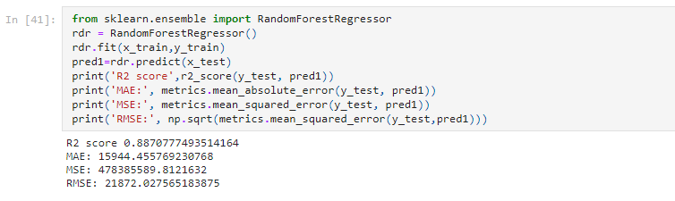
Model Training
After Cross Validation the best fit model is RandomForestClassifier Model with R2 score of 0.88

Slide 15
THANK U

